Slide 1
Basic Electrical and Electronics Engineering
LECTURE 1.9
Dr. Sonam Shrivastava/ Assistant Professor (Sr.) /SELECT

Slide 2
BEEE102L
Basic Electrical and Electronics Engineering
DC Circuits
AC Circuits
Magnetic Circuits
Electrical Machines
Semiconductor Devices and Applications
Digital Systems

Slide 3
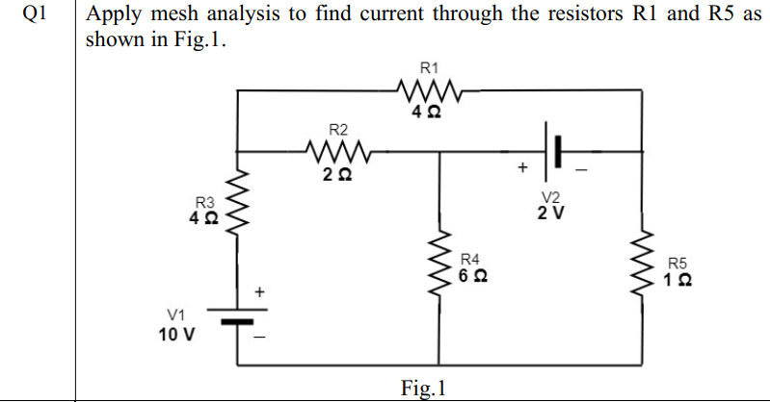

Slide 4


Slide 5
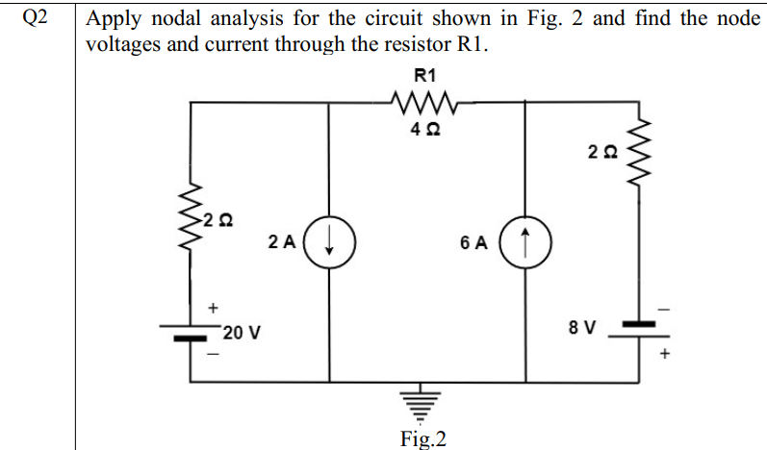

Slide 6


Slide 7
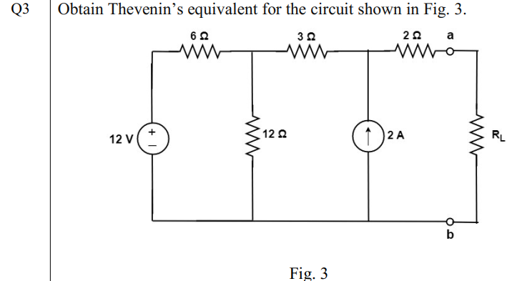

Slide 8


Slide 9
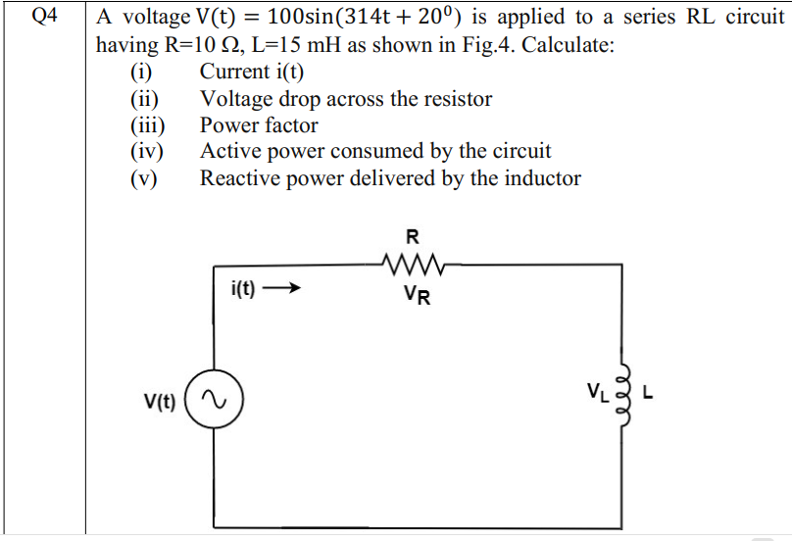

Slide 10
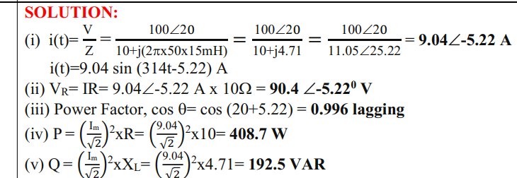

Slide 11
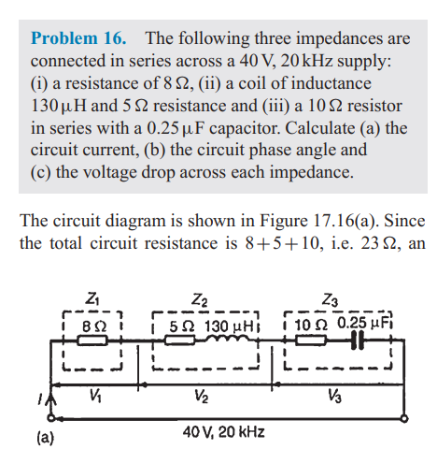
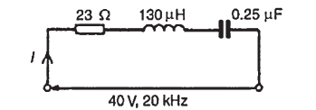

Slide 12
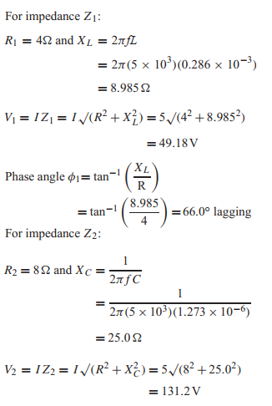
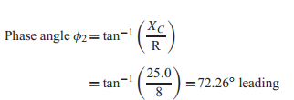

Slide 13
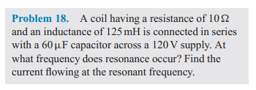

Slide 14
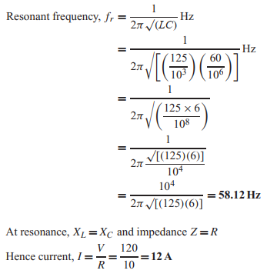

Slide 15
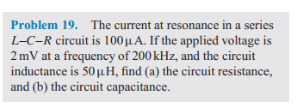

Slide 16
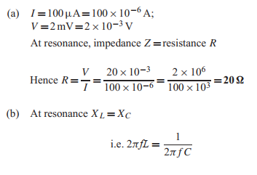
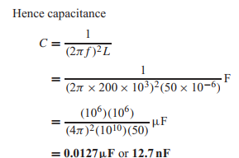

Slide 17
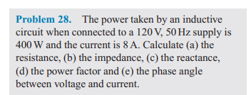

Slide 18
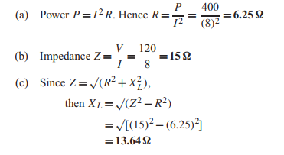
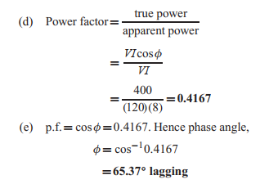

Slide 19
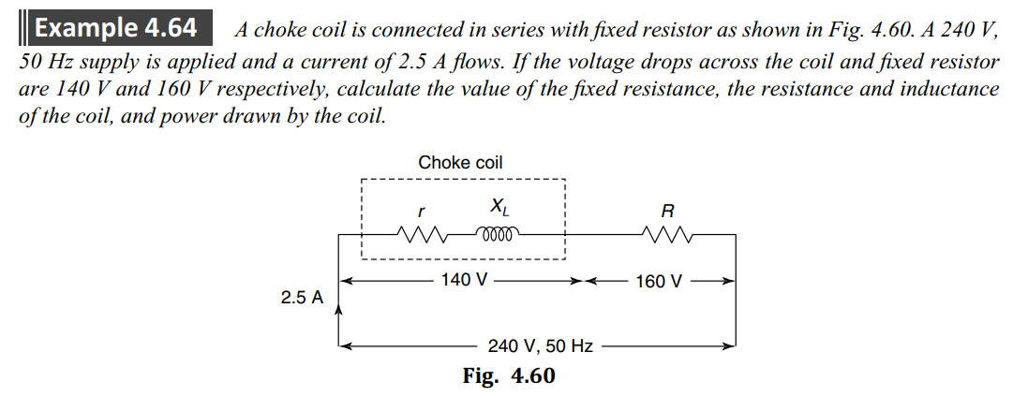

Slide 20
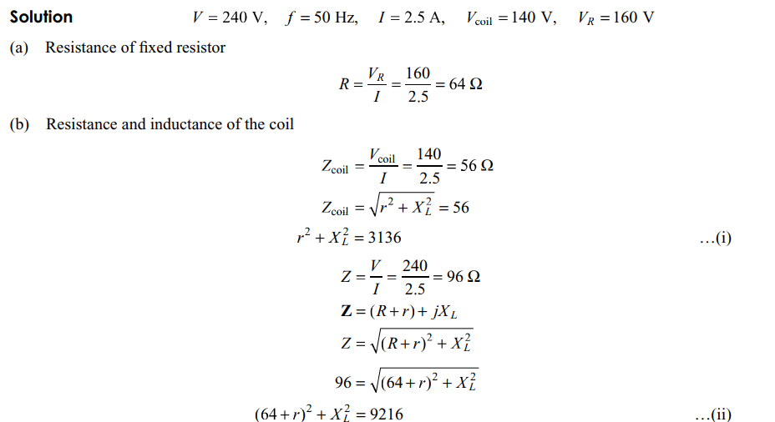

Slide 21
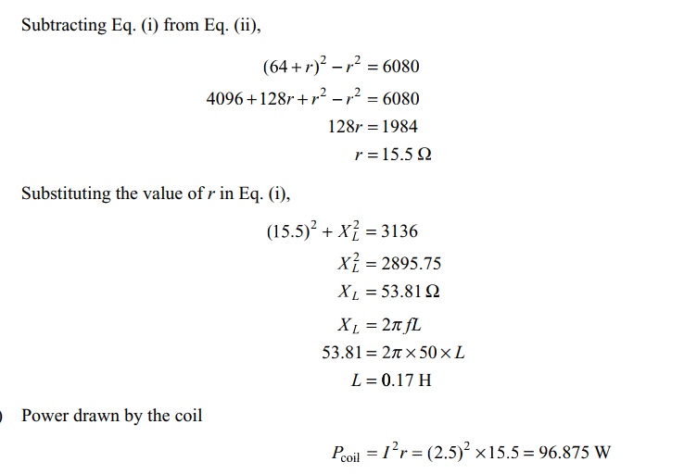

Slide 22


Slide 23


Slide 24

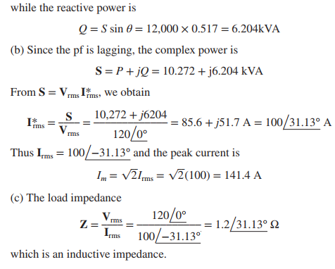

Slide 26
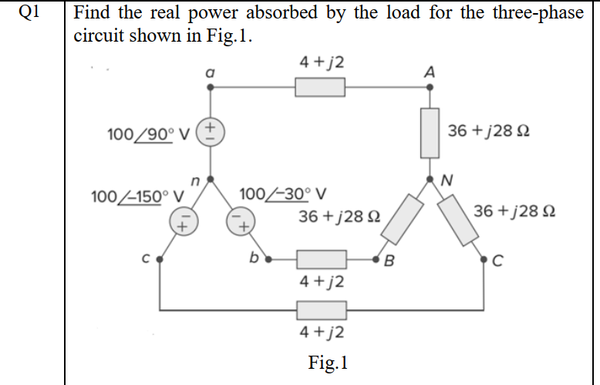

Slide 27
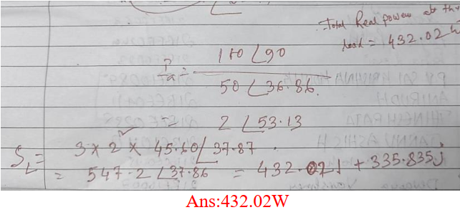

Slide 28


Slide 29


Slide 30
Design a combinational circuit with three inputs and one output.
(a) The output is 1 when the binary value of the inputs is less than3. The output is otherwise.
(b) The output is 1 when the binary value of the inputs is an odd number.
(C) The output is 1 when the binary value of the inputs is an even number.

